Slide 1
Loss Prevention
Retail
SMB

Slide 2
Loss Prevention
What is Loss Prevention?
Retail loss prevention is a set of practices employed by retail companies to preserve profit.
Profit preservation is any business activity specifically designed to reduce preventable losses.
A preventable loss is any business cost caused by deliberate or inadvertent human actions, knows as “shrink”.
Deliberate human actions that cause loss to a retail company can be theft, fraud, vandalism, waste, abuse, or misconduct.
Inadvertent human actions attributable to loss are purely poorly execute business processes, where employees fail to follow existing policies or procedures.

Slide 3
Counterpoint Functionality for Loss Prevention
Smart Alerts
Point of Sale Reports
Sales History Reports
Security Settings
Menu Codes
Cash Drawer Configurations
Track a User on Every Transaction
Reason Codes

Slide 4
Smart Alerts

Slide 5
Smart Alerts
Fraud Alerts
Fraud Alerts
Fraud Alerts
Excessive Price Overrides Applied
Large Price Override Applied
Price Override Summary
Excessive Return Transactions
Return Transaction Summary
Refund After Close
Refund Before Open
Sale After Close
Sale Before Open
Sign in Before Open
Sign In After Close
Ticket entry Sign In Before Open
Ticket Entry Sign In After Close
Excessive Voided tickets*
Excessive No Sale Transactions*
Excessive Discounts Applied*
Large Discount Applied*

Slide 6
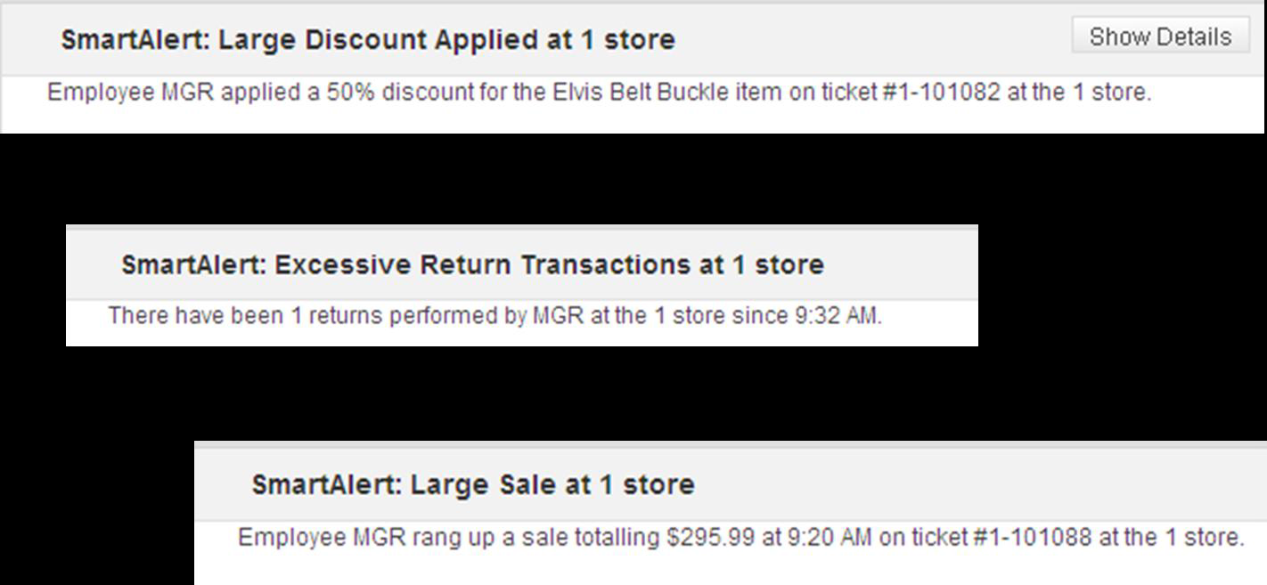
Sample Smart Alerts

Slide 7
Point of Sale Reports

Slide 8
Point of Sale Reports
Main / Point of Sale / Reports
POS Exception
Requires Data Aggregation
Price Exceptions
Unposted Tickets
History Report / Drawer History
History

Slide 9
Sales History Reports

Slide 10
Point of Sale Reports
Main / Point of Sale / Reports
POS Exception
Requires Data Aggregation
Price Exceptions
Unposted Tickets
History Report / Drawer History
History

Slide 11
Security Settings

Slide 12
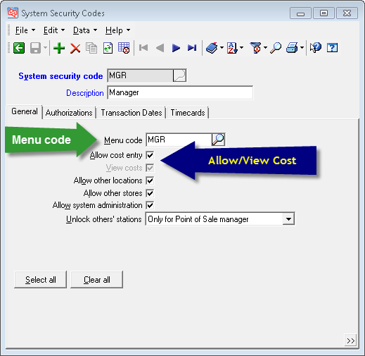
Setup/System/Security Codes

Slide 13
Menu Codes

Slide 14
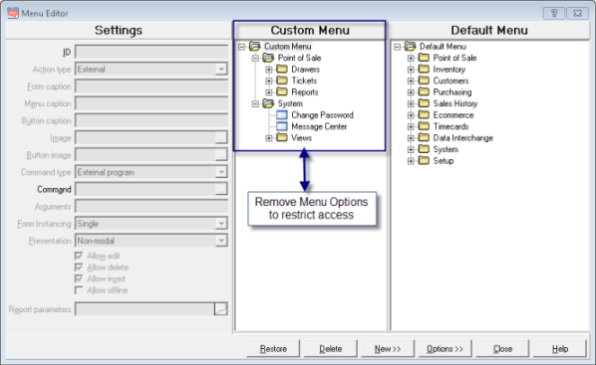
Setup/System/Menu Codes
Notes:
Remove items to take away capability

Slide 15
POS Security Codes

Slide 16
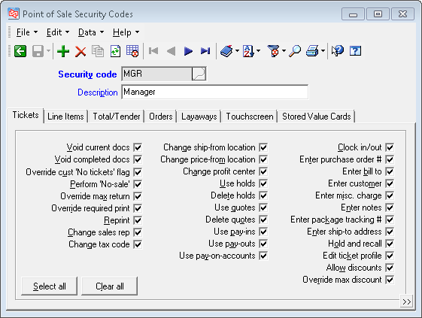
Setup/Point of Sale/Security Codes

Slide 17
Paycodes

Slide 18
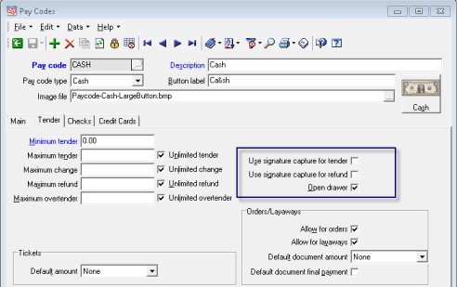
Setup/Point of Sale/Paycodes

Slide 19
Drawer Alarm

Slide 20
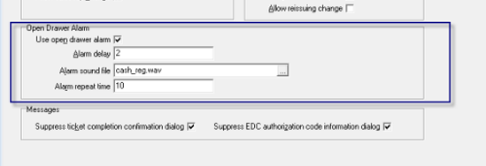
Setup/Point of Sale/Stores/Ticket Tab 2
Define if you want to use the Open Drawer alarm
Select Delay
Select Sound File
Set Repeat Time
Note in 8.4 the system beep will
sound if there is no sound file
found or no sound card.

Slide 21
Track A User on Every Transaction

Slide 22
Setup/Point of Sale/Stores/Ticket Tab 2
If you allow a station or register to be shared by multiple employees, turn on this feature to track who’s ringing up which sales. If the drawer is short, you won’t know who did it, but you’ll be able to narrow it down.

Slide 23
Reason Codes

Slide 24
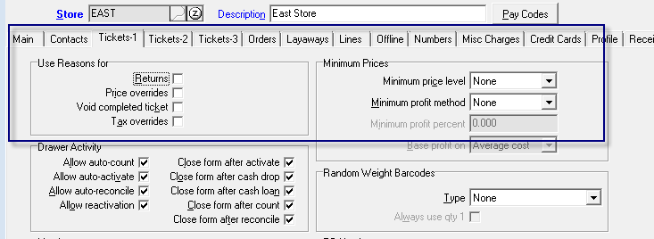
Setup/Point of Sale/Stores/Ticket Tab 1
Set Reasons for
Returns
Price Overrides
Voids
Tax Overrides

Slide 25
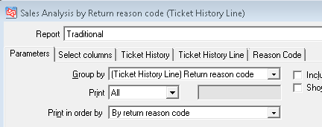
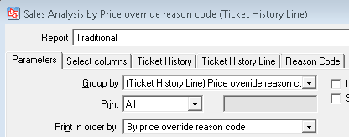
Sales History/Reports/SA By Group
Group Report by Reason Code

Slide 26
Display Item Images

Slide 27
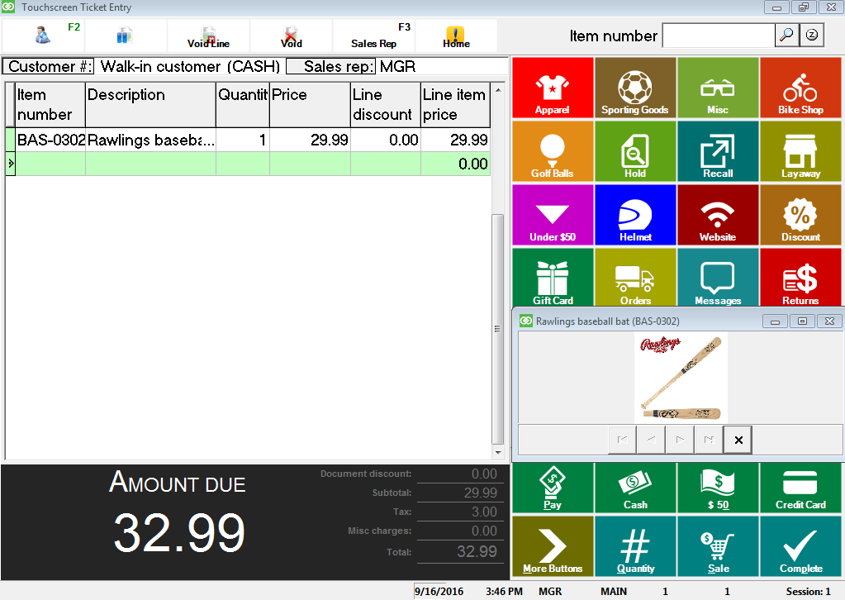
Setup/Point of Sale/Station/Show Item Images
Select to show item images to verify the customer didn’t switch a price tag

Slide 28
Inadvertent Loss Best Practices

Slide 29
Training
Practice Company
Webinars/Recordings on Counterpoint user site
Touchscreen Ticket Entry
Button to a Word File of Procedures
Using fly over text for hints

Slide 30
Message Center
Keep Employees Up-to-Date on Changes or Additions to Procedures
Under System / Message Center, you have a closed email system that allows you to communicate with employees. Individuals or groups. Use this to communicate changes or additions to business processes.

Slide 31
Other Suggestions

Slide 32
Other
Secure your physical Store
An alarm system on the perimeter
Security Cameras on the sales floor and the register
User logins
Two-factor Authentication on the network
Change passwords frequently
Make complex passwords

Slide 33
Thank You
Promo Code SAF30
30 Days Free Smart Alerts

